Slide 1

Cars HWA project
Tashfeen Arshad

Slide 2
Introduction
My approach
breakdown the project requirement into its parts and approach it methodically
Backend- use Springboot to create the API that connects to a MySQL database and to use POST,GET,PULL and DELETE
Use postman to see if the requests work
Frontend- use HTML,CSS and JS to programme the webpage
Use AXIOS to access the API endpoints
Testing- use unit and intergation testing, aiming to achieve 80% coverage.

Slide 3
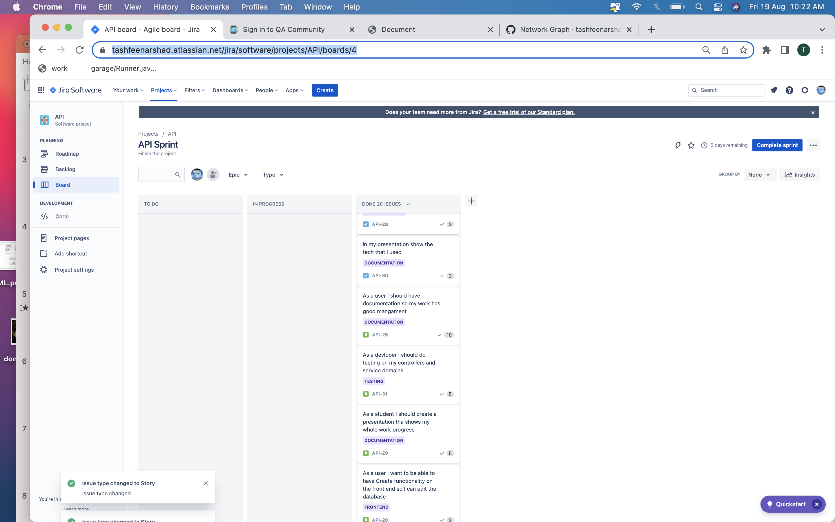
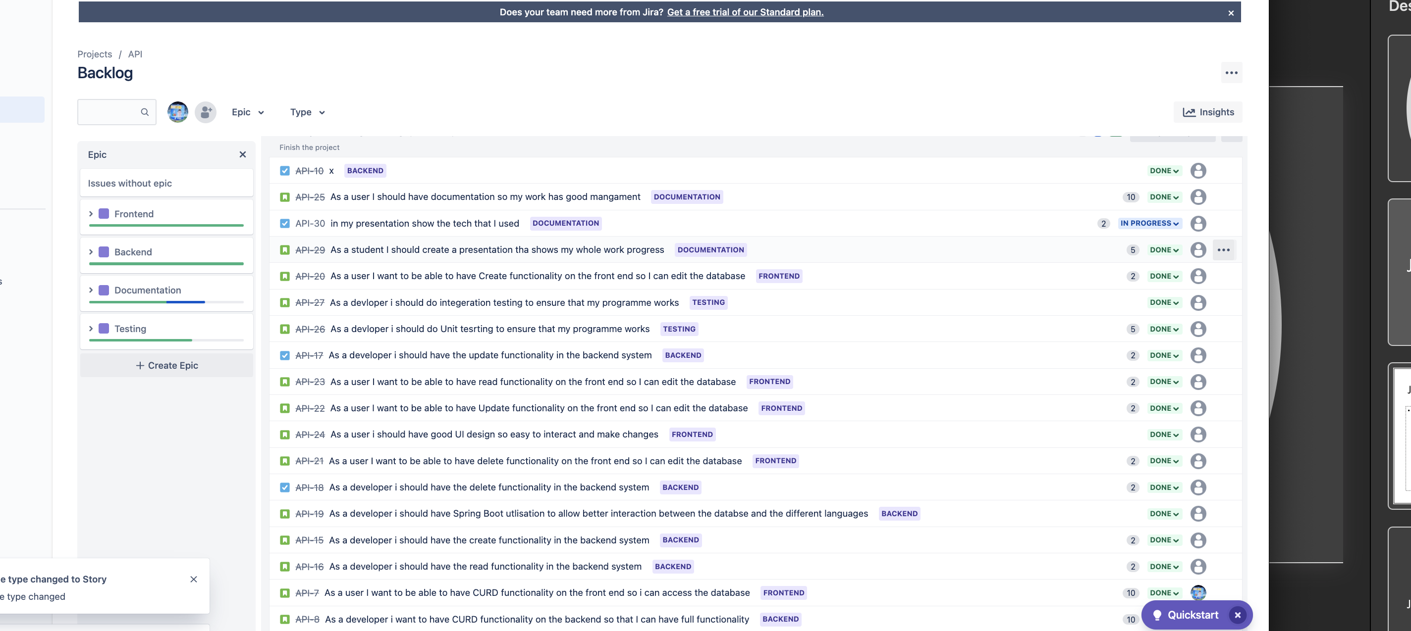
Jira Plan

Slide 4
Tech Stack
Java/SpringBoot
MySQL
Postman
Axios
Swagger
HTML
CSS
JS
GitHub

Slide 5
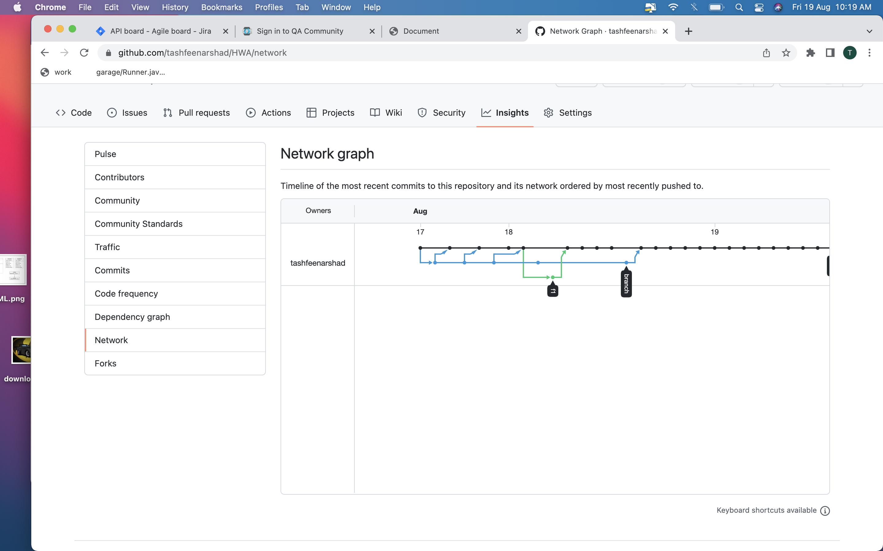
Version Control
Use the FBM model

Slide 6
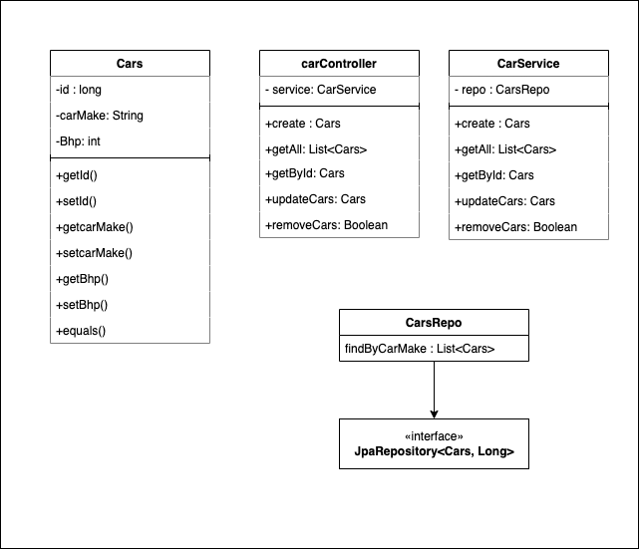
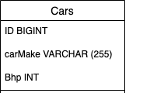
ERL and UML

Slide 7
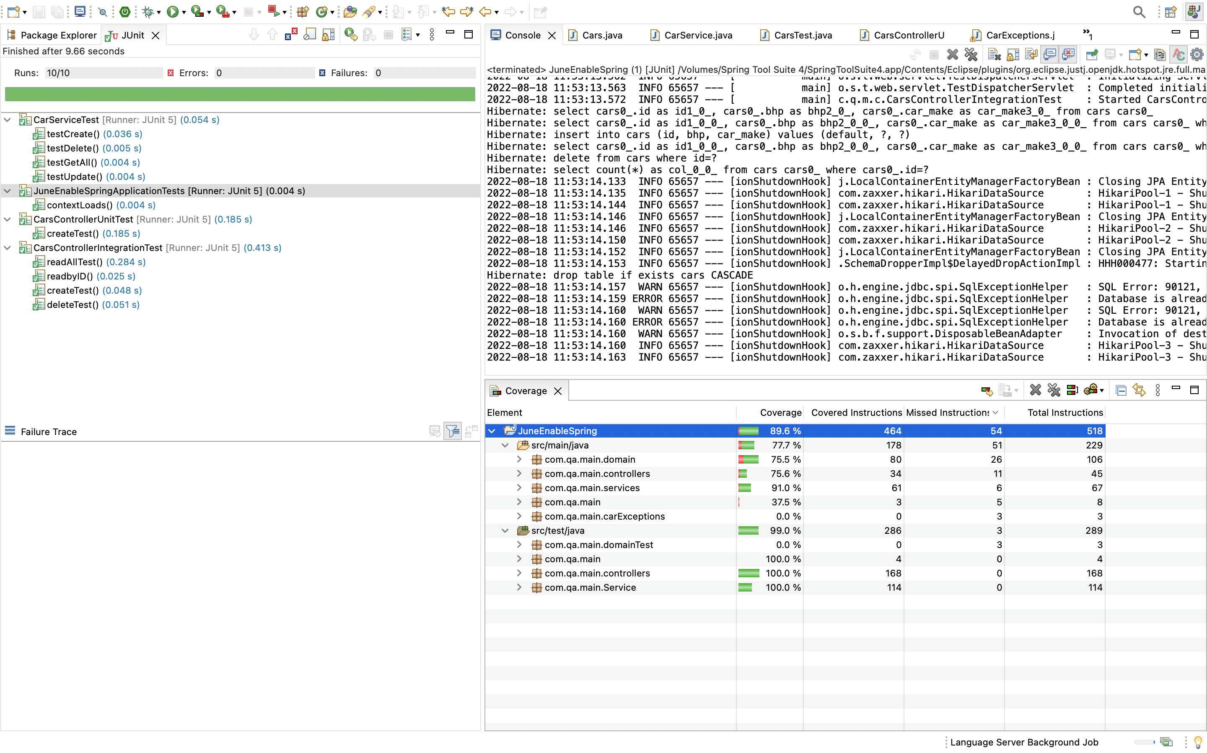
Testing
89.6% coverage achieved

Slide 8

DEMO

Slide 9
Review
Pros-
Achieved MVP
Got more than 80% coverage
Gained excellent experience in building an API
A much better understanding of JS
Much better at debugging code especially how to utilise the resources I have
Cons
More understanding of Github especially using terminal
Frontend can use much better design and more quality of life features can be added
More functionality can be added to the backend system such as admin features and users
Allow different filter features

Slide 10

Questions?

